Slide 1


Sitecore 10 Content Serialization Deep-dive for Developers SITECORE USER GROUP PUNE AUG 21, 2021

Slide 2

Sitecore Content Serialization
Sitecore DB
Sitecore (Kernel) DLL
Sitecore Serialization Bin DLLs
PowerShell Command
Sitecore Serialization Client DLLs
Module.json
Schema.json

Slide 3
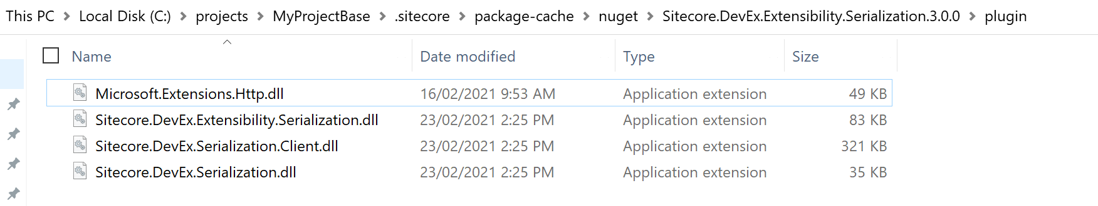
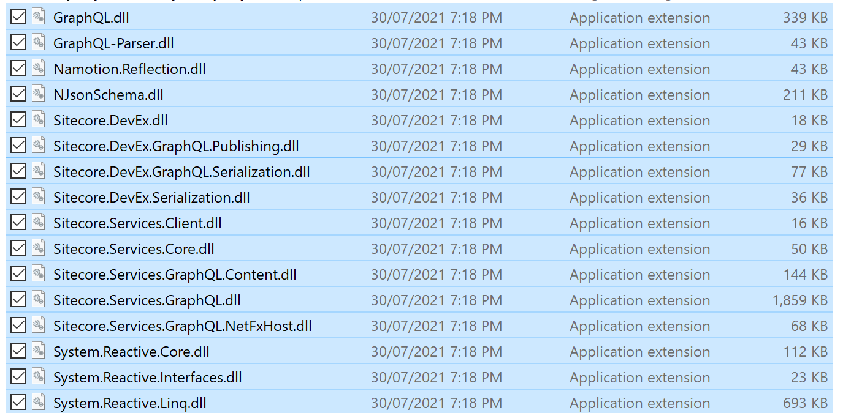
Content Serialization DLLs
Plugin DLLs | Bin DLLs
Microsoft.Extensions.Http.dll | GraphQL.dll
Sitecore.DevEx.Extensibility.Serialization.dll | GraphQL-Parser.dll
Sitecore.DevEx.Serialization.Client.dll | Namotion.Reflection.dll
Sitecore.DevEx.Serialization.dll | NJsonSchema.dll
 | Sitecore.DevEx.dll
 | Sitecore.DevEx.dll

Slide 4
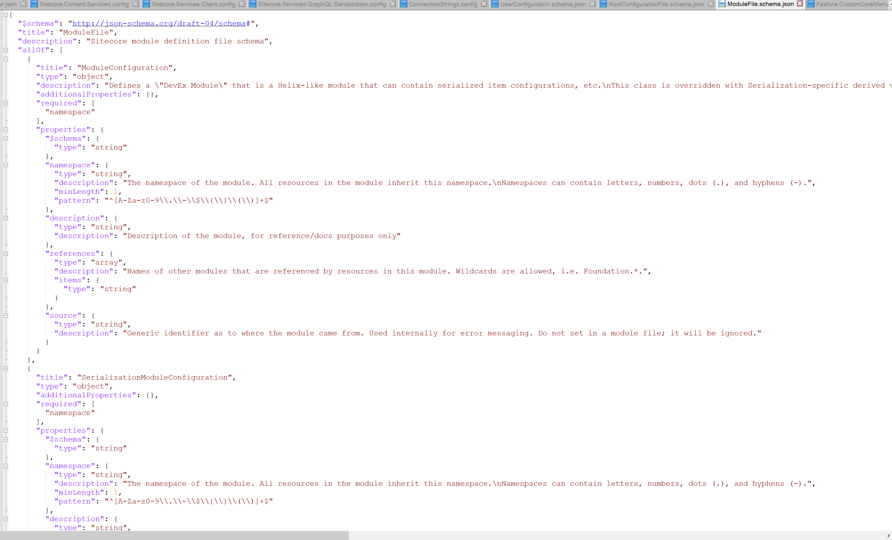
The Heart
ModuleFile.schema.json:
Location - <dev folder>\.sitecore\schemas

Slide 5
Analysis through a few Errors

Slide 6
PS Error-1: Passing a wrong db name in module.json

Slide 7
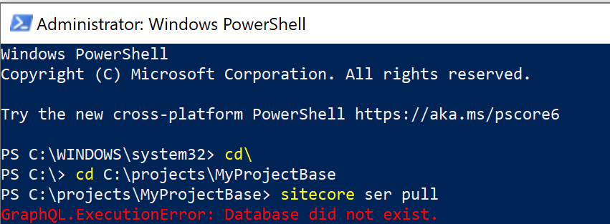
PowerShell Error - 1
GraphQL.ExecutionError: Database did not exist.

Slide 8
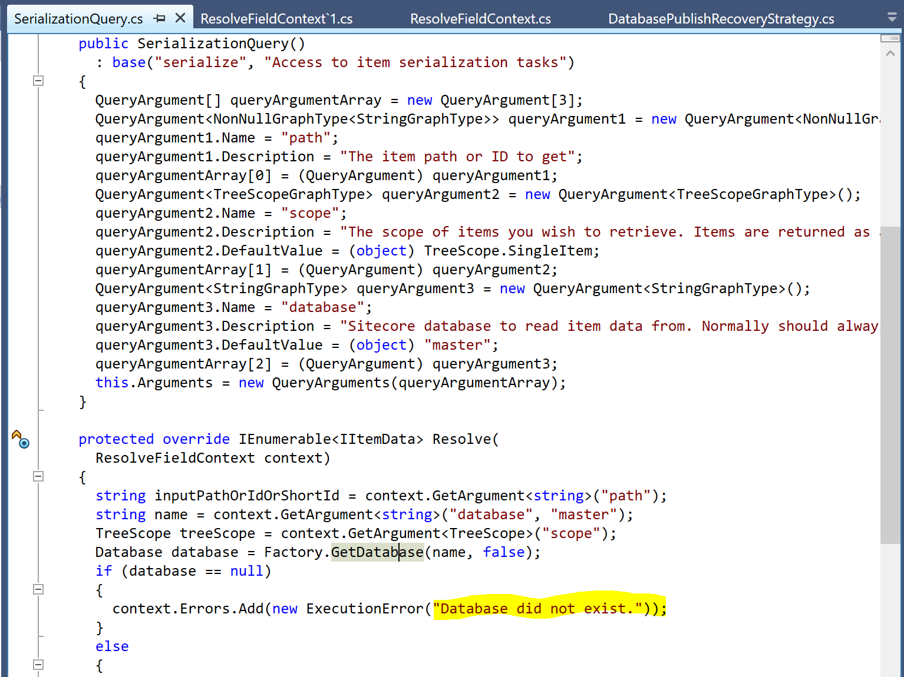
Code Analysis
Only one occurrence (in Sitecore.DevEx.GraphQL.Serialization.dll):
ctrl+Alt+T to search string in dotpeek

Slide 9
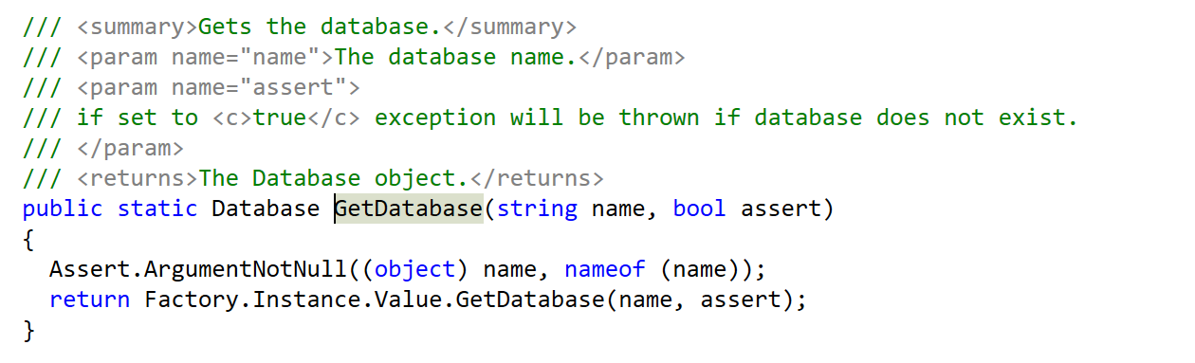
Code Analysis
The Factory.GetDatabase passes the db name in this case and fails to get the database:

Slide 10
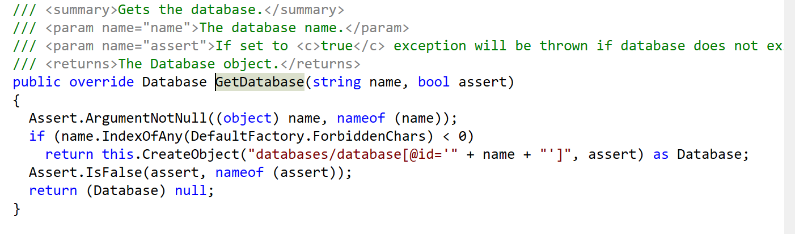
Code Analysis
Subsequent call:

Slide 11
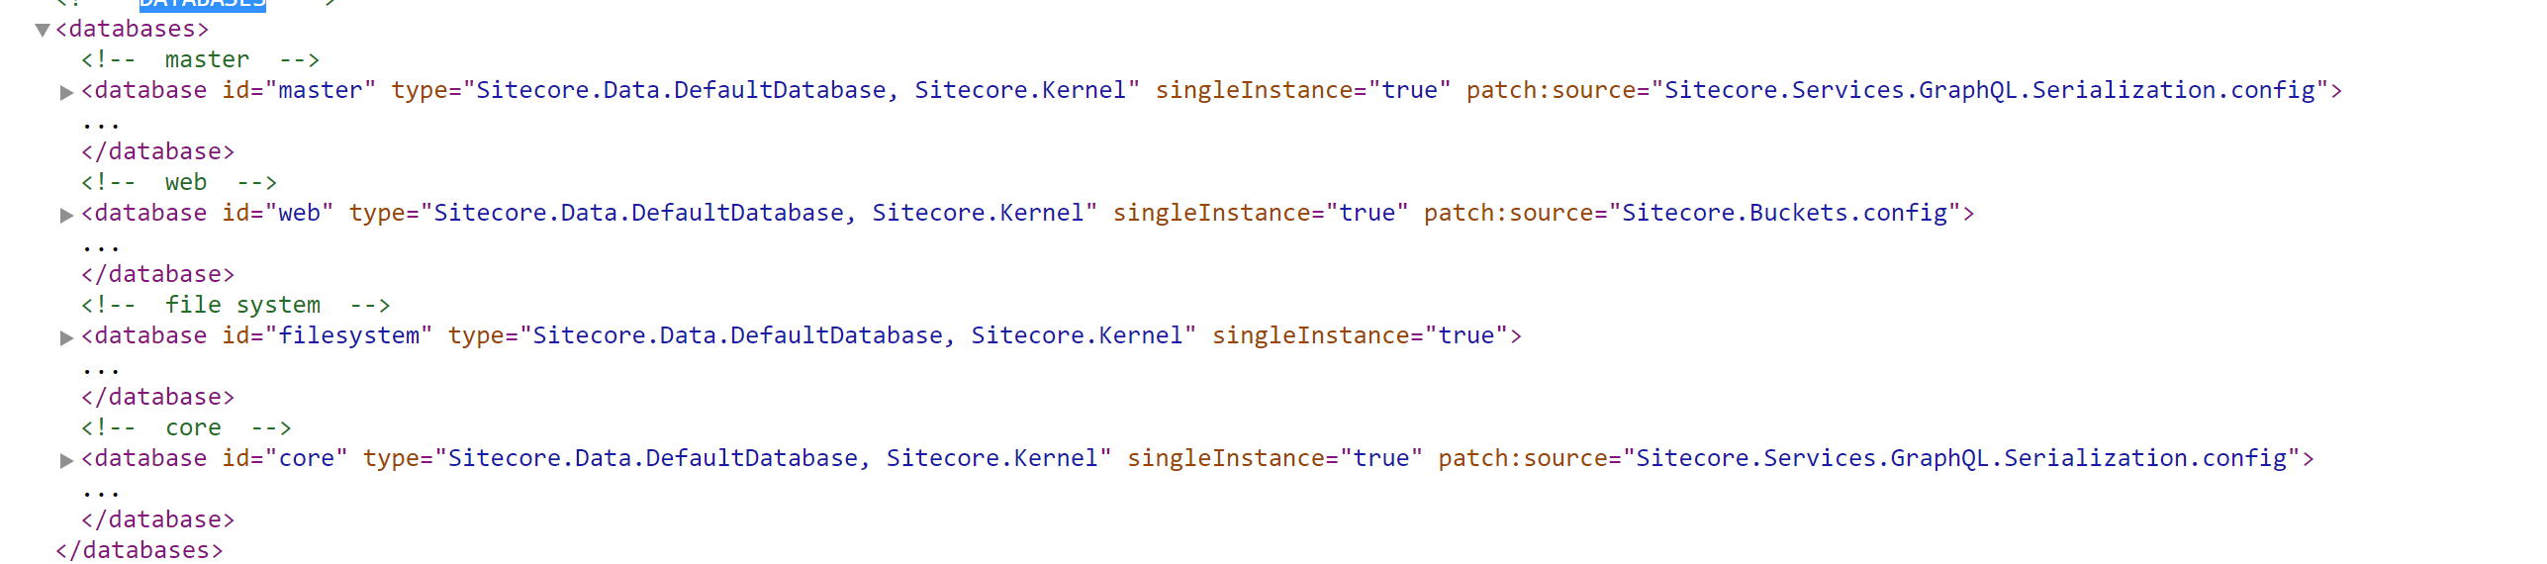
A list of databases in showconfig.aspx
The patch from Sitecore.Services.GraphQL.Serialization.config:

Slide 12
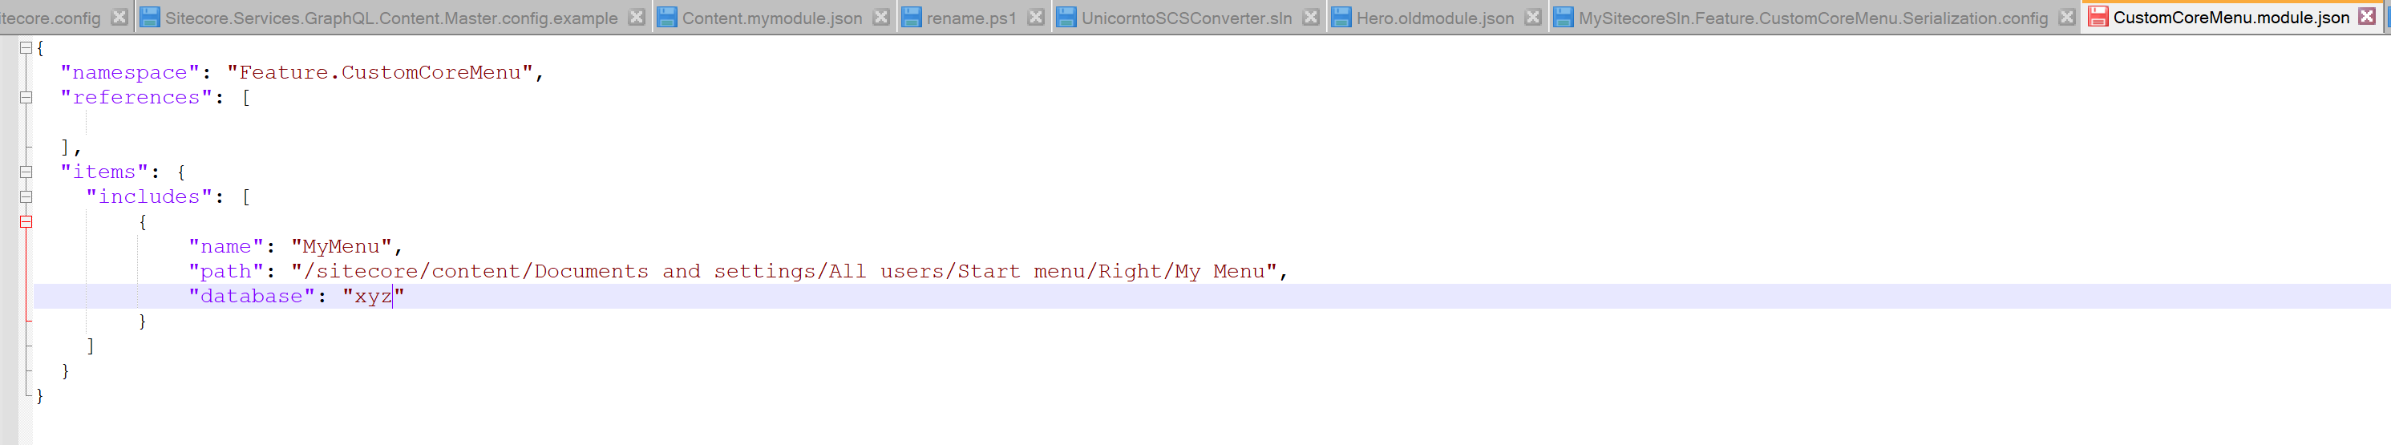
Actual Issue
So, a missing id in the databases\database list can cause the PS error. An example is one here below:

Slide 13
PS Error-2: Passing a wrong db name to Sitecore.Kernel

Slide 14
PowerShell Error - 2
Unexpected HttpResponseMessage with code: InternalServerError

Slide 15
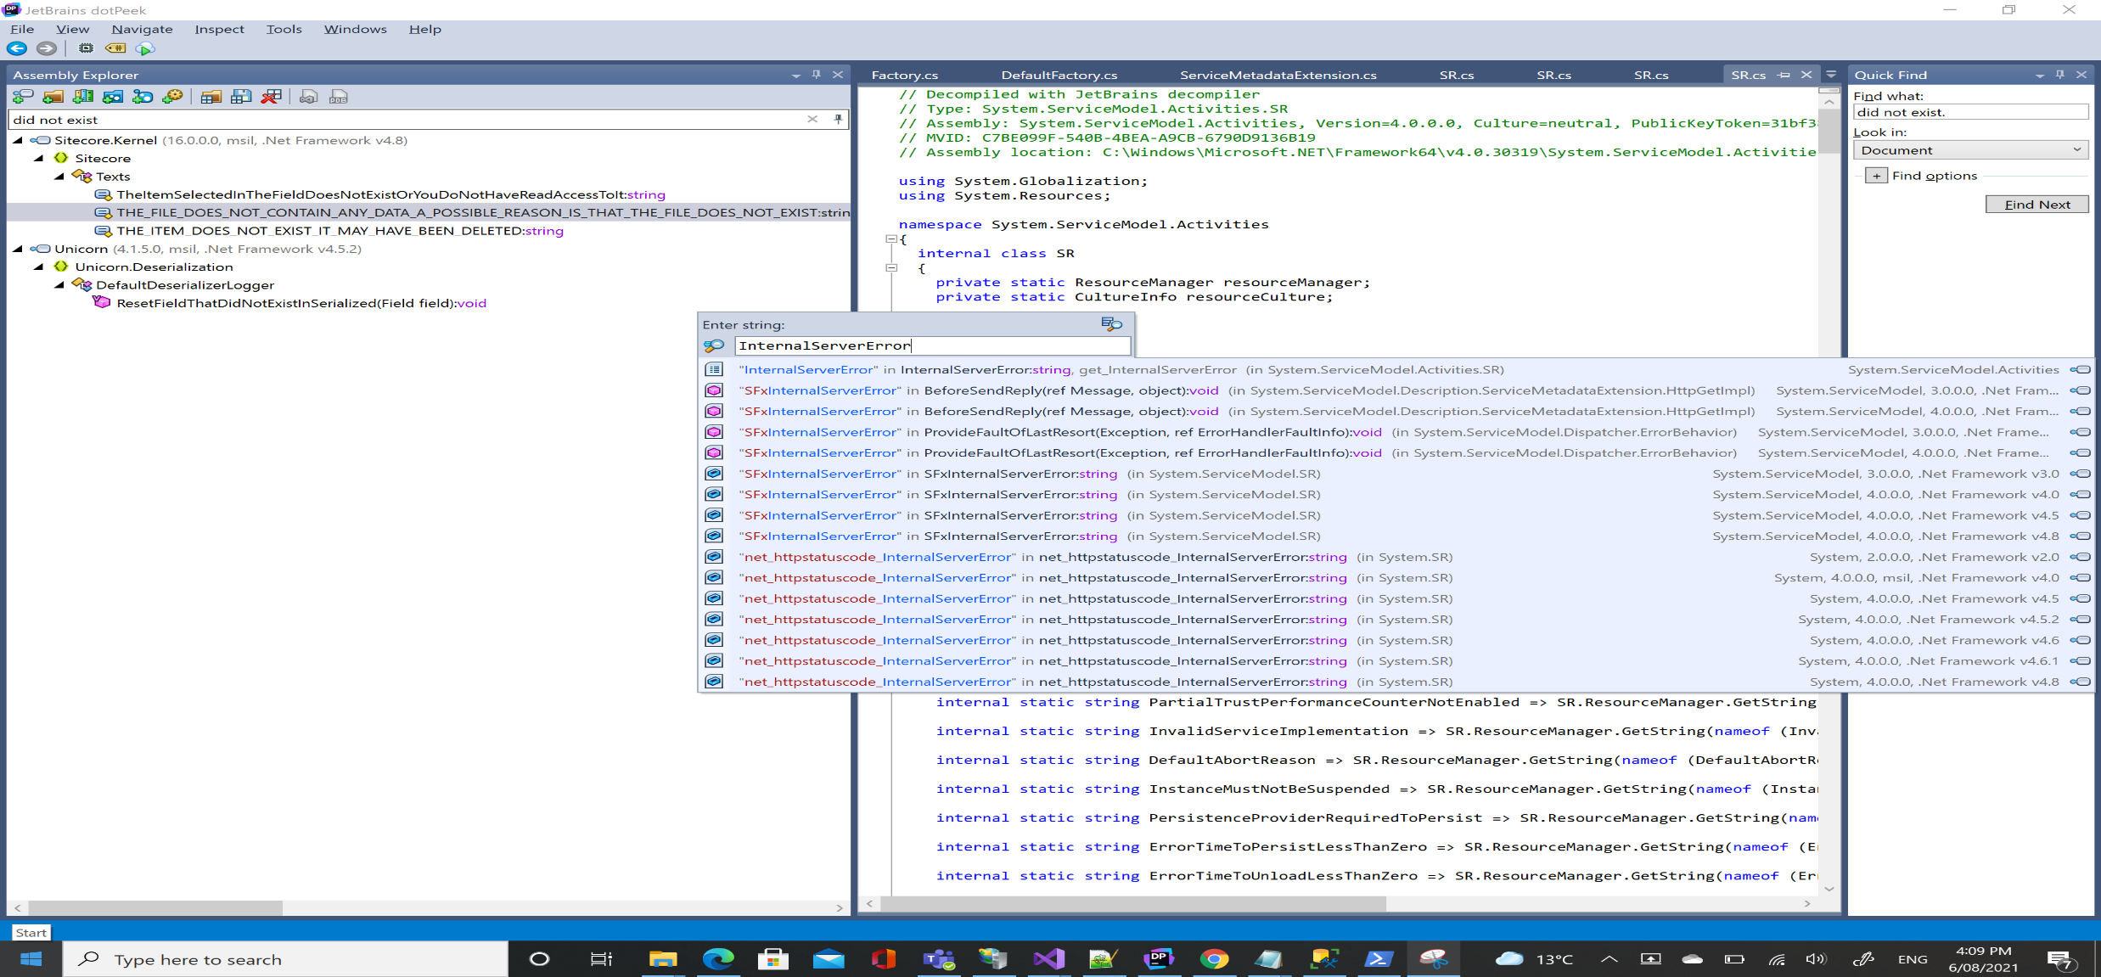
Code Analysis
Many results:

Slide 16
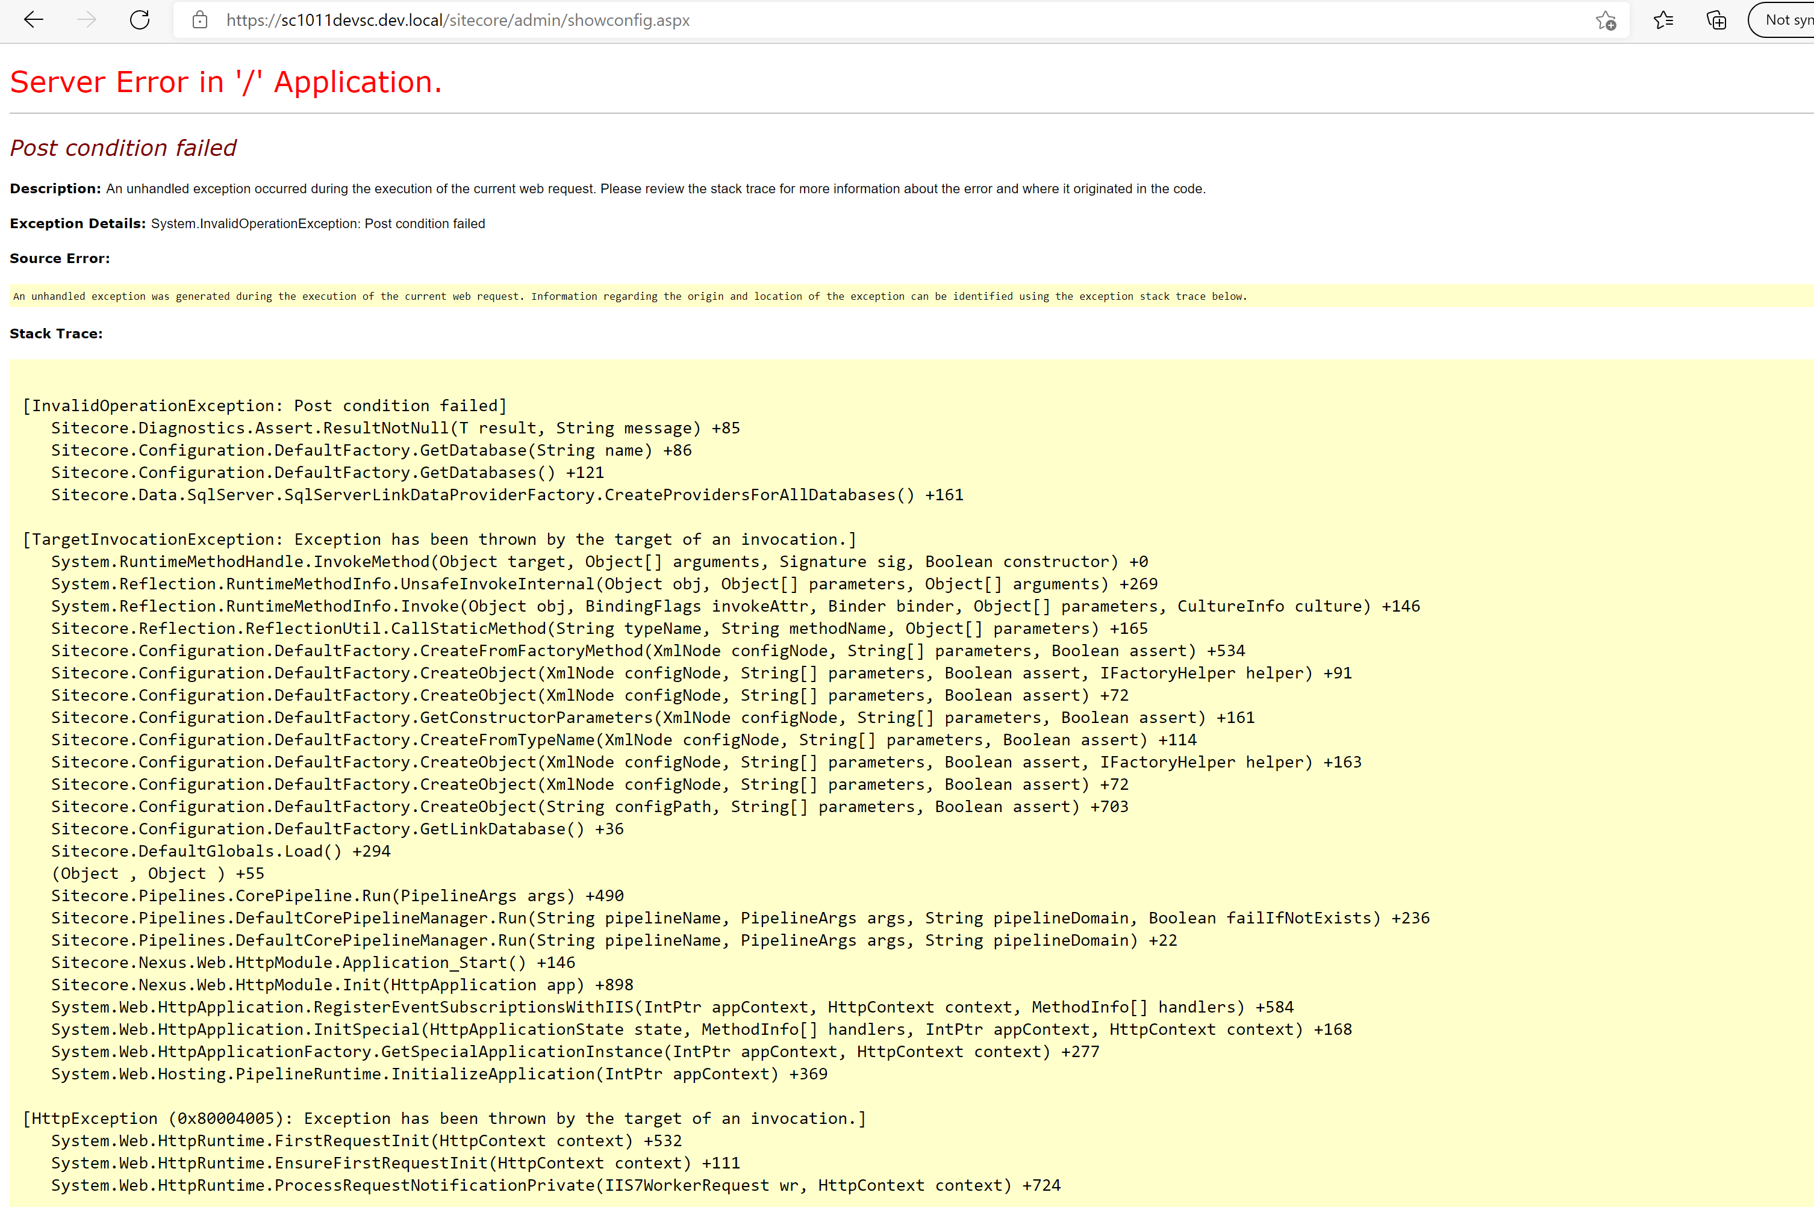
Showconfig.aspx
YSOD:

Slide 17
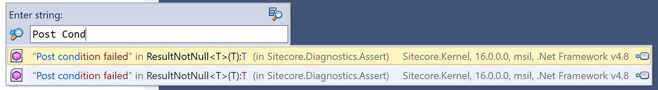
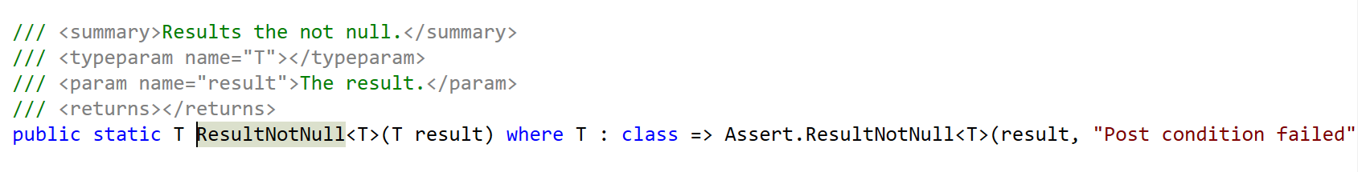
Code Analysis

Slide 18
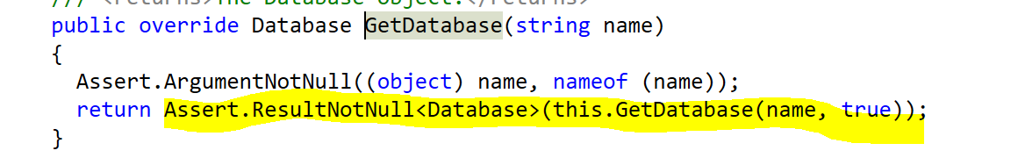
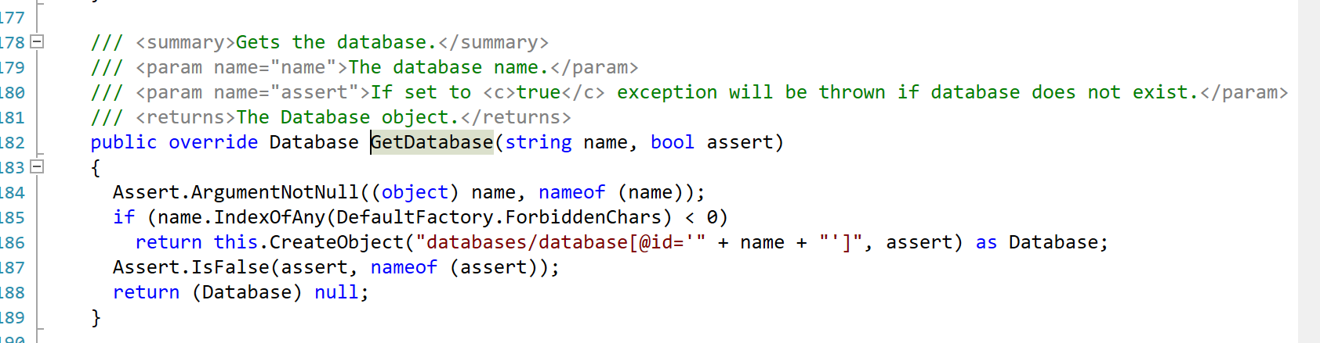
Code Analysis
If a non-existent database is passed the error is thrown:

Slide 19
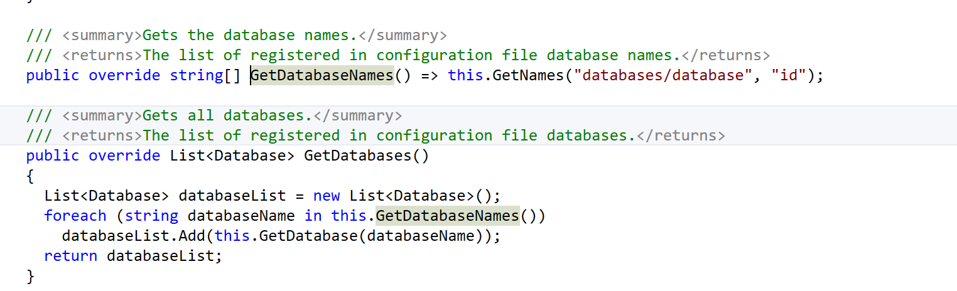
Code Analysis
GetDatabase invoked in a loop:

Slide 20
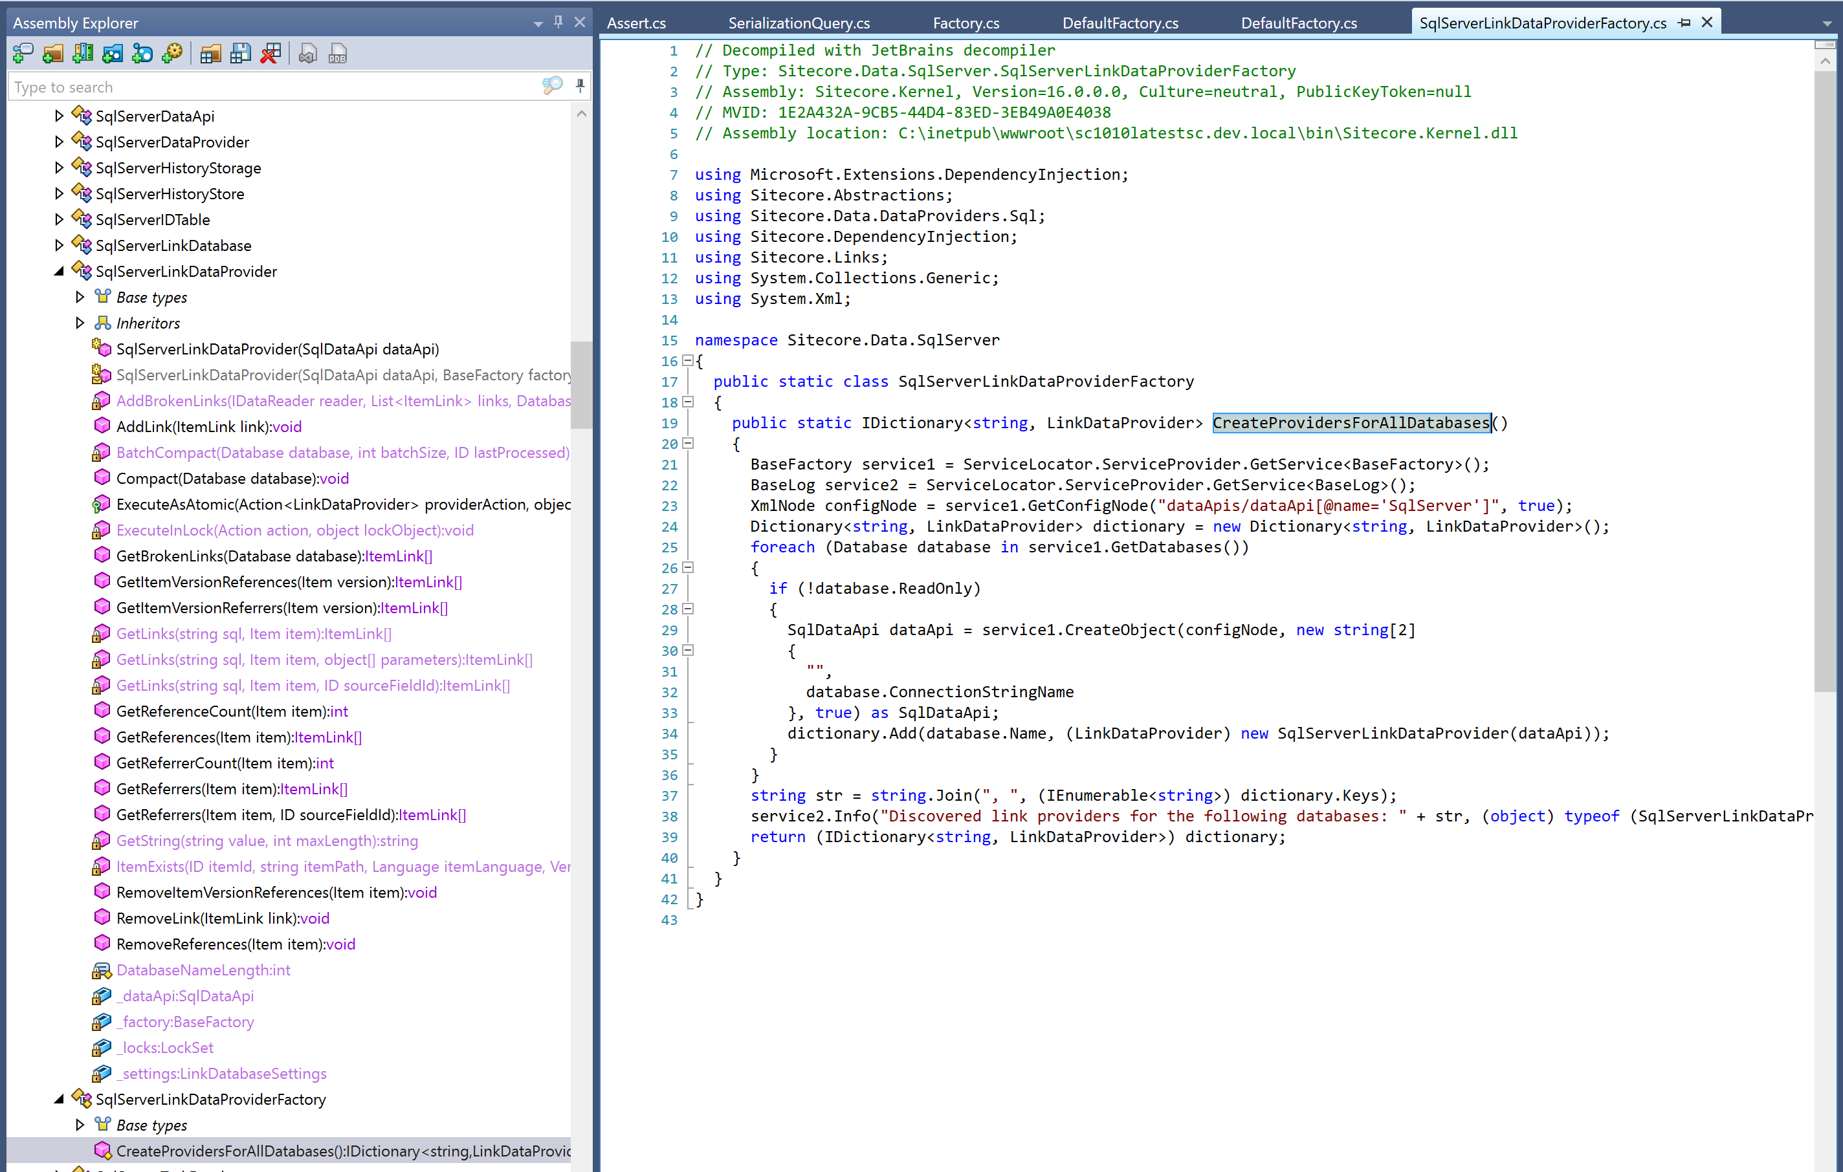
Code Analysis

Slide 21
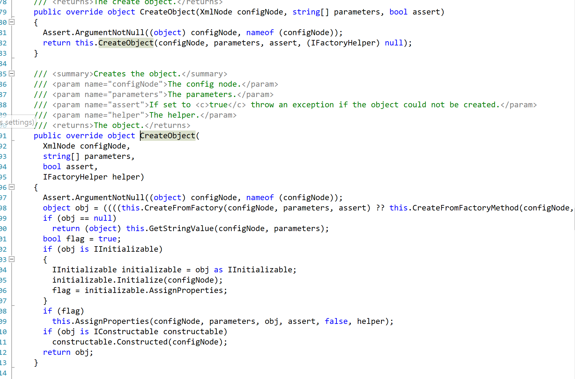
Code Analysis
CreateObject fails as a result:

Slide 22
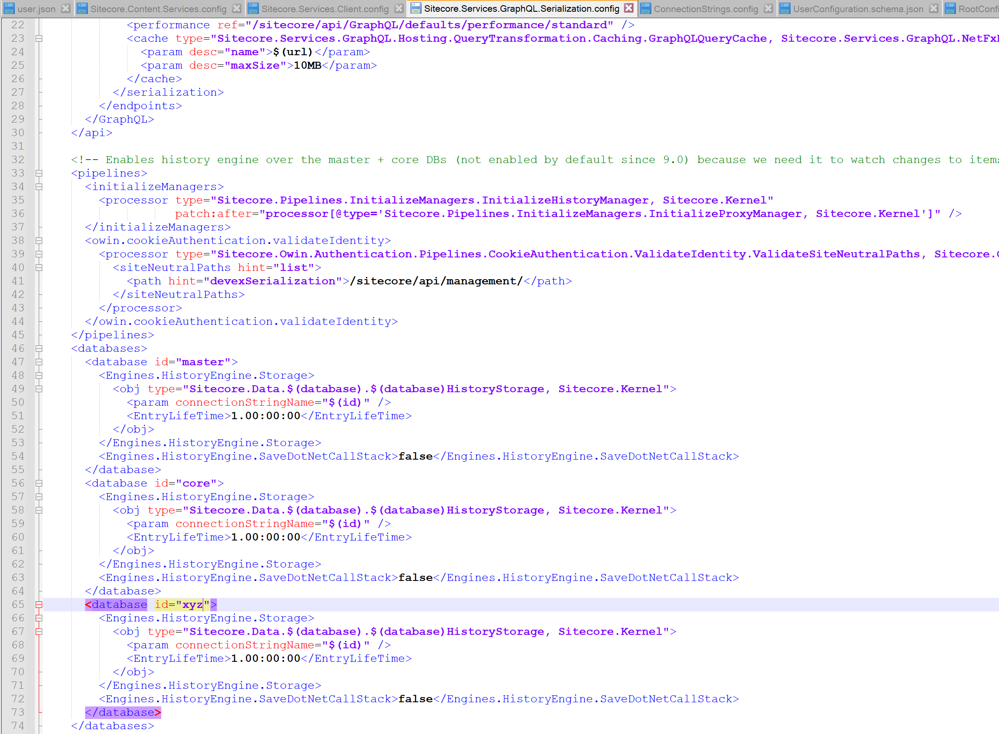
Actual Issue
Pass a non-existent xyz db:

Slide 23
PS Error-3: Passing a wrong db name based on item

Slide 24
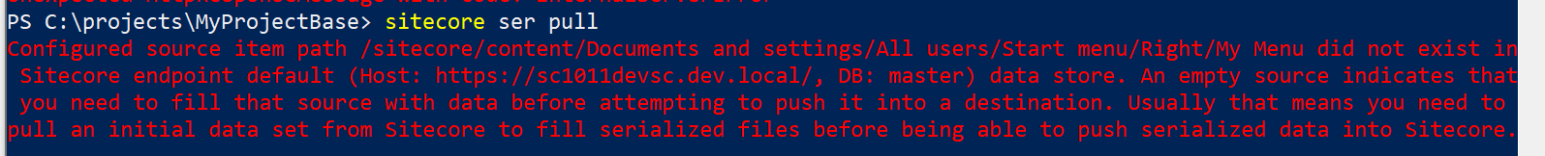
PowerShell Error - 3
Pass a wrong db and pull:

Slide 25
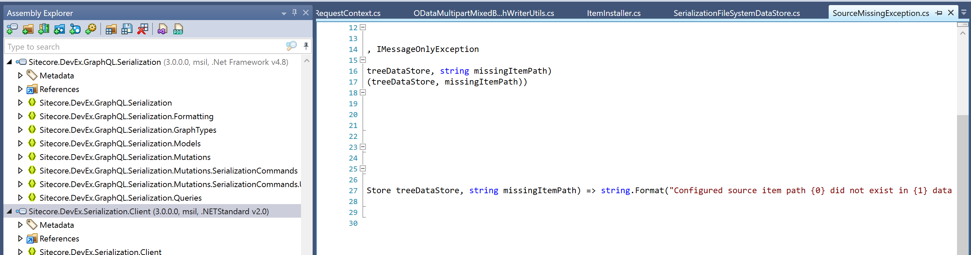
Code Analysis
This error comes from Sitecore.DevEx.Serialization.Client.dll:

Slide 26
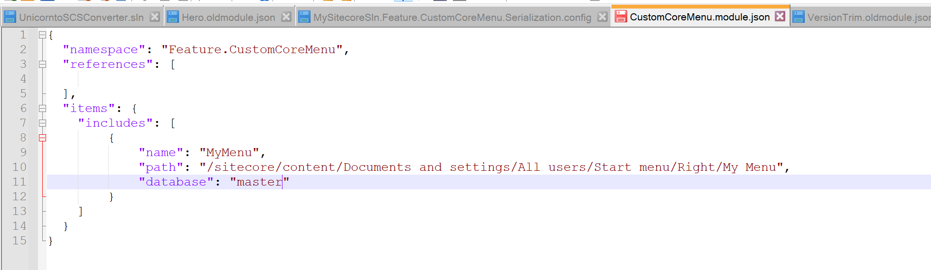
Actual Issue
Master instead of Core DB throws the error:

Slide 27
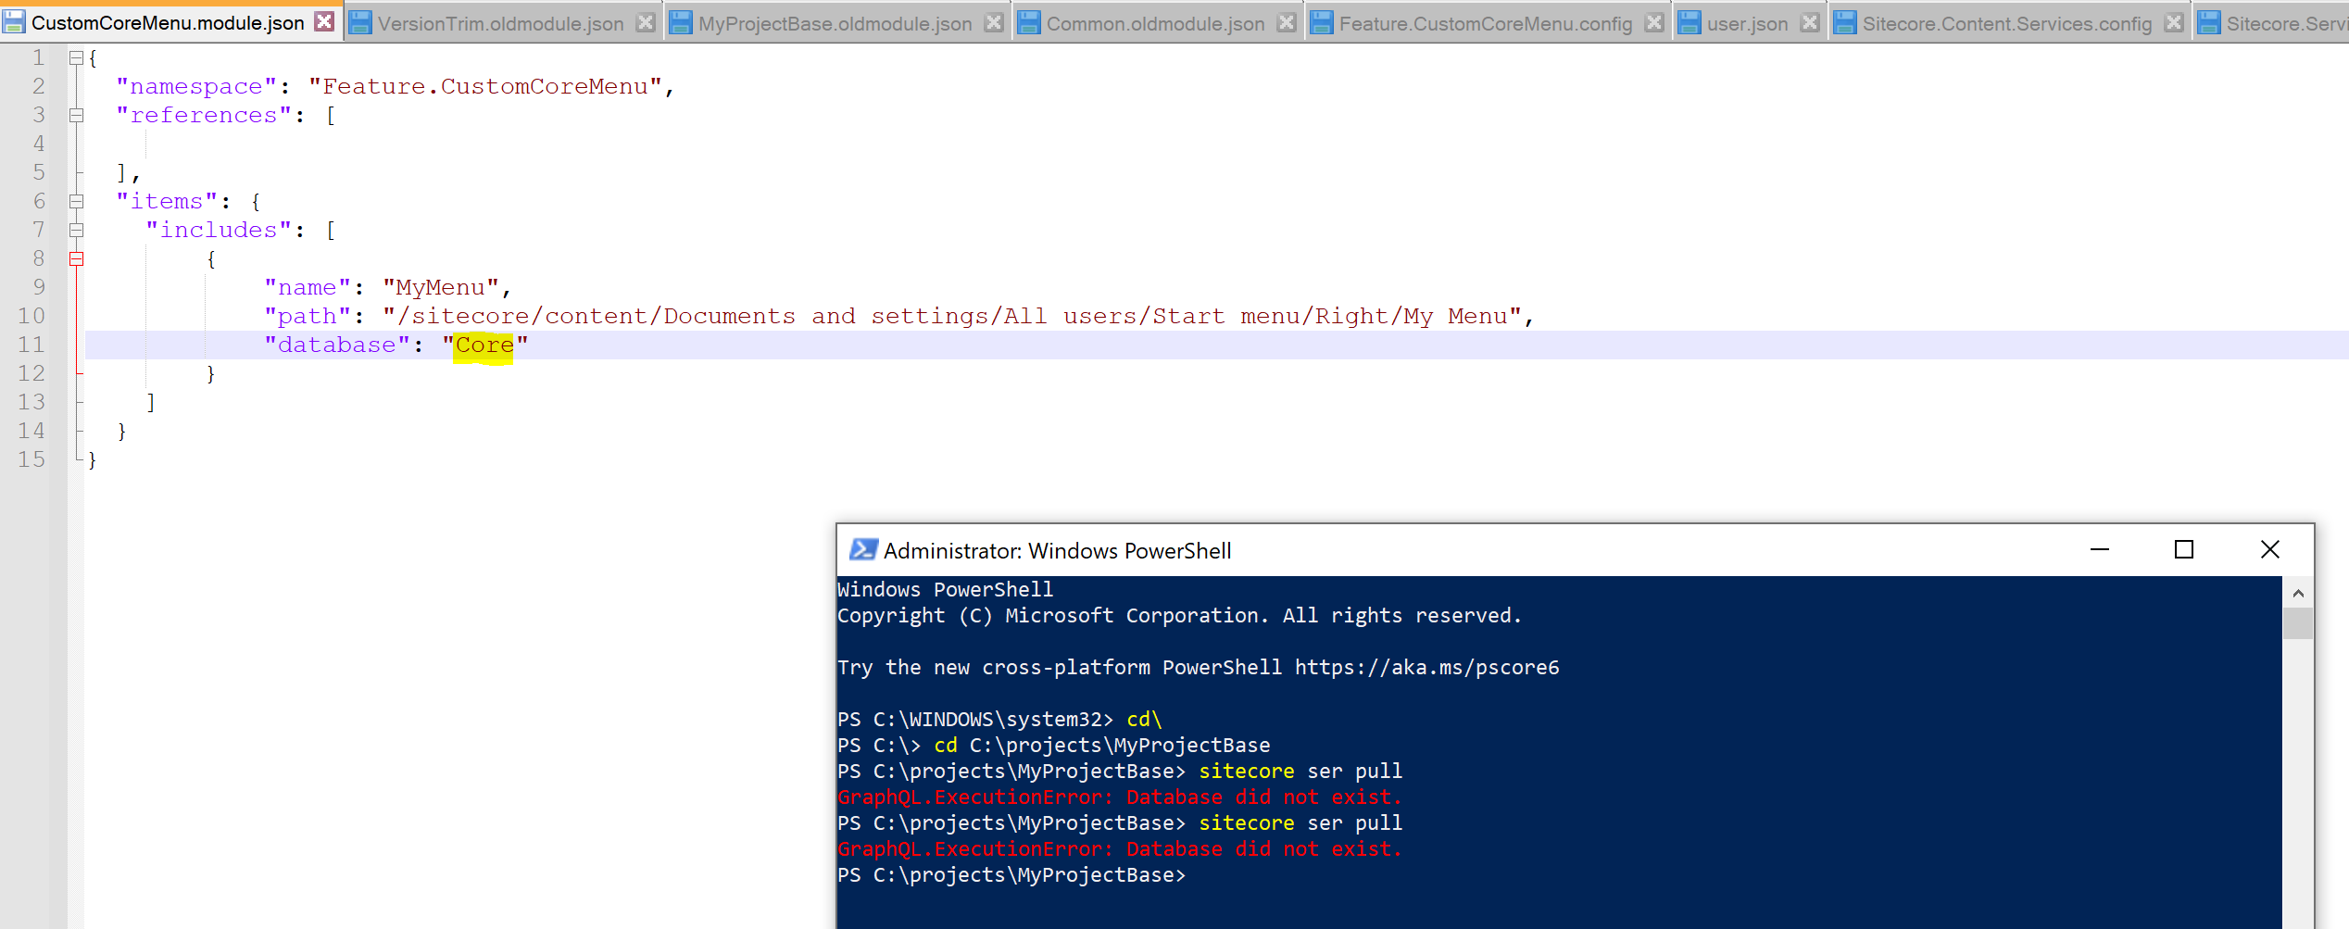
Database Name is case-sensitive
This one did not exist since it must be core instead of Core:

Slide 28
SCS in Action

Slide 29
CLI Command Flow
PowerShell
File System
Dotnet new tool-manifest
Dotnet-tools json within .config folder created successfully

Slide 30
CLI Command Flow
PowerShell
File System
dotnet tool install Sitecore.CLI --add-source https://sitecore.myget.org/F/sc-packages/api/v3/index.json
Dotnet-tools json updated with Sitecore.CLI version successfully

Slide 31
CLI Command Flow
PowerShell
File System
dotnet sitecore init
JSON Schema files , settings and Sitecore JSON files created successfully

Slide 32
CLI Command Flow
PowerShell
File System
Sitecore Instance
dotnet sitecore login --authority <id server url> --cm <cm server url> --allow-write true
User.json created and updated successfully
Token, user and site details

Slide 33
CLI Command Flow
File System
Sitecore Myget
PowerShell
dotnet sitecore plugin add -n Sitecore.DevEx.Extensibility.Serialization
Sitecore.DevEx.Extensibility.Serialization successfully installed (package-cache folder)
Get Plugin

Slide 34
CLI Command Flow
PowerShell
File System
sitecore ser--help
Plugin Commands appear successfully

Slide 35
SCS in Helix Project

Slide 36
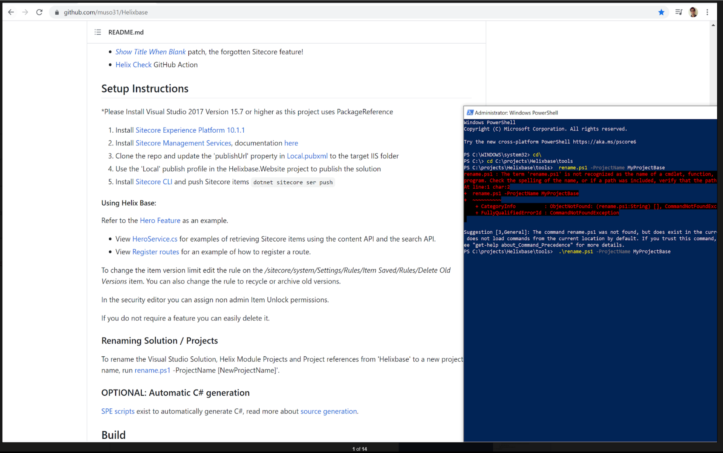
Setup HelixBase project
Clone https://github.com/muso31/Helixbase
Run rename.ps1

Slide 37
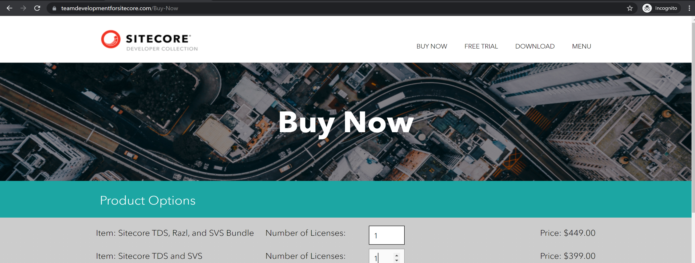
SVS - Module Explorer
https://doc.sitecore.com/en/developers/100/developer-tools/create-and-install-a-sitecore-content-serialization-package.html

Slide 38
Poor Man’s SCS Module Explorer

Slide 39
Poor Man’s Module Explorer Features
Feature | Yes
Auto Install Sitecore CLI | 
Auto Generate json schema, settings and Sitecore json files | 
Auto Create user.json | 
Auto Install Serialization Plugin | 
Auto Generate Default json files across helix layers | 
Load pre-existing module json from helix project structure | 
Display json side-by-side in ui as you make changes | 
Validate Module Json | 

Slide 40
Poor Man’s Module Explorer Features
Feature | Yes
Save edited JSON | 
Add / edit /delete module details (in json) | 
Add / edit /delete rule details (both ui and json) | 
Rule Explanation | 
Sync and Serialize Options | 
Licensed? | 

Slide 41
Poor Man’s Module Explorer Features
- Configure the project source path in a json file
- On a button click, Installs the serialization plugin and sets up user.json in the concerned Helix project base folder - On a button click, Traverses the Helix structure and creates default module.json for foundation , feature and project layers - On a button click, Rule addition and explanation, apart from option to save the edited json - Sync and Serialize available on a button click

Slide 42
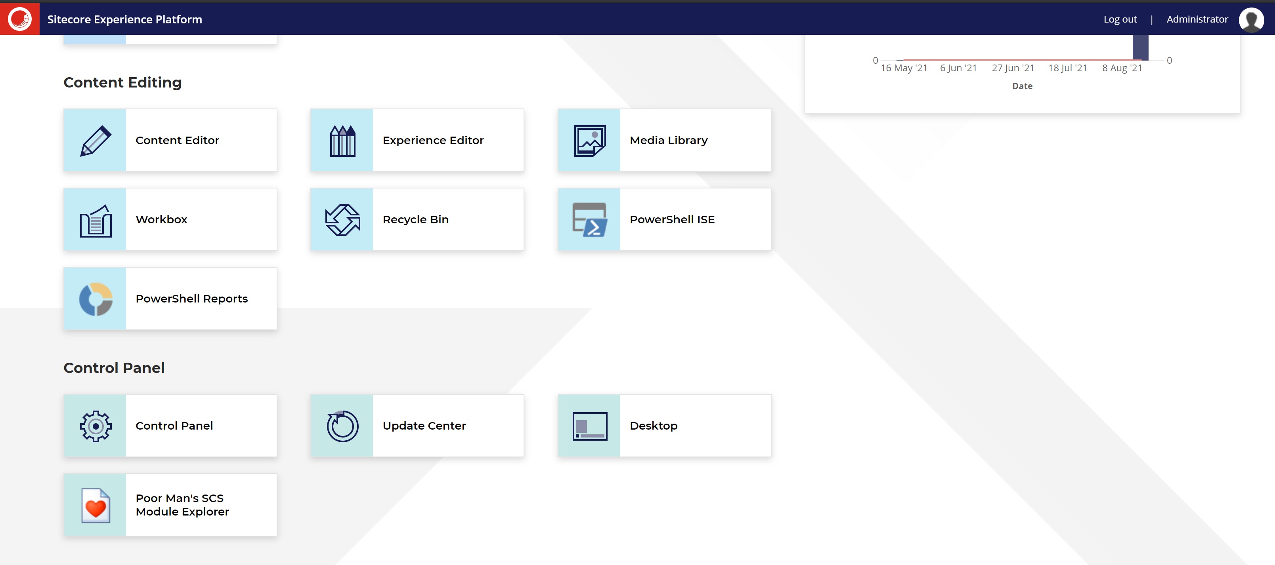
Poor Man’s Module Explorer

Slide 43
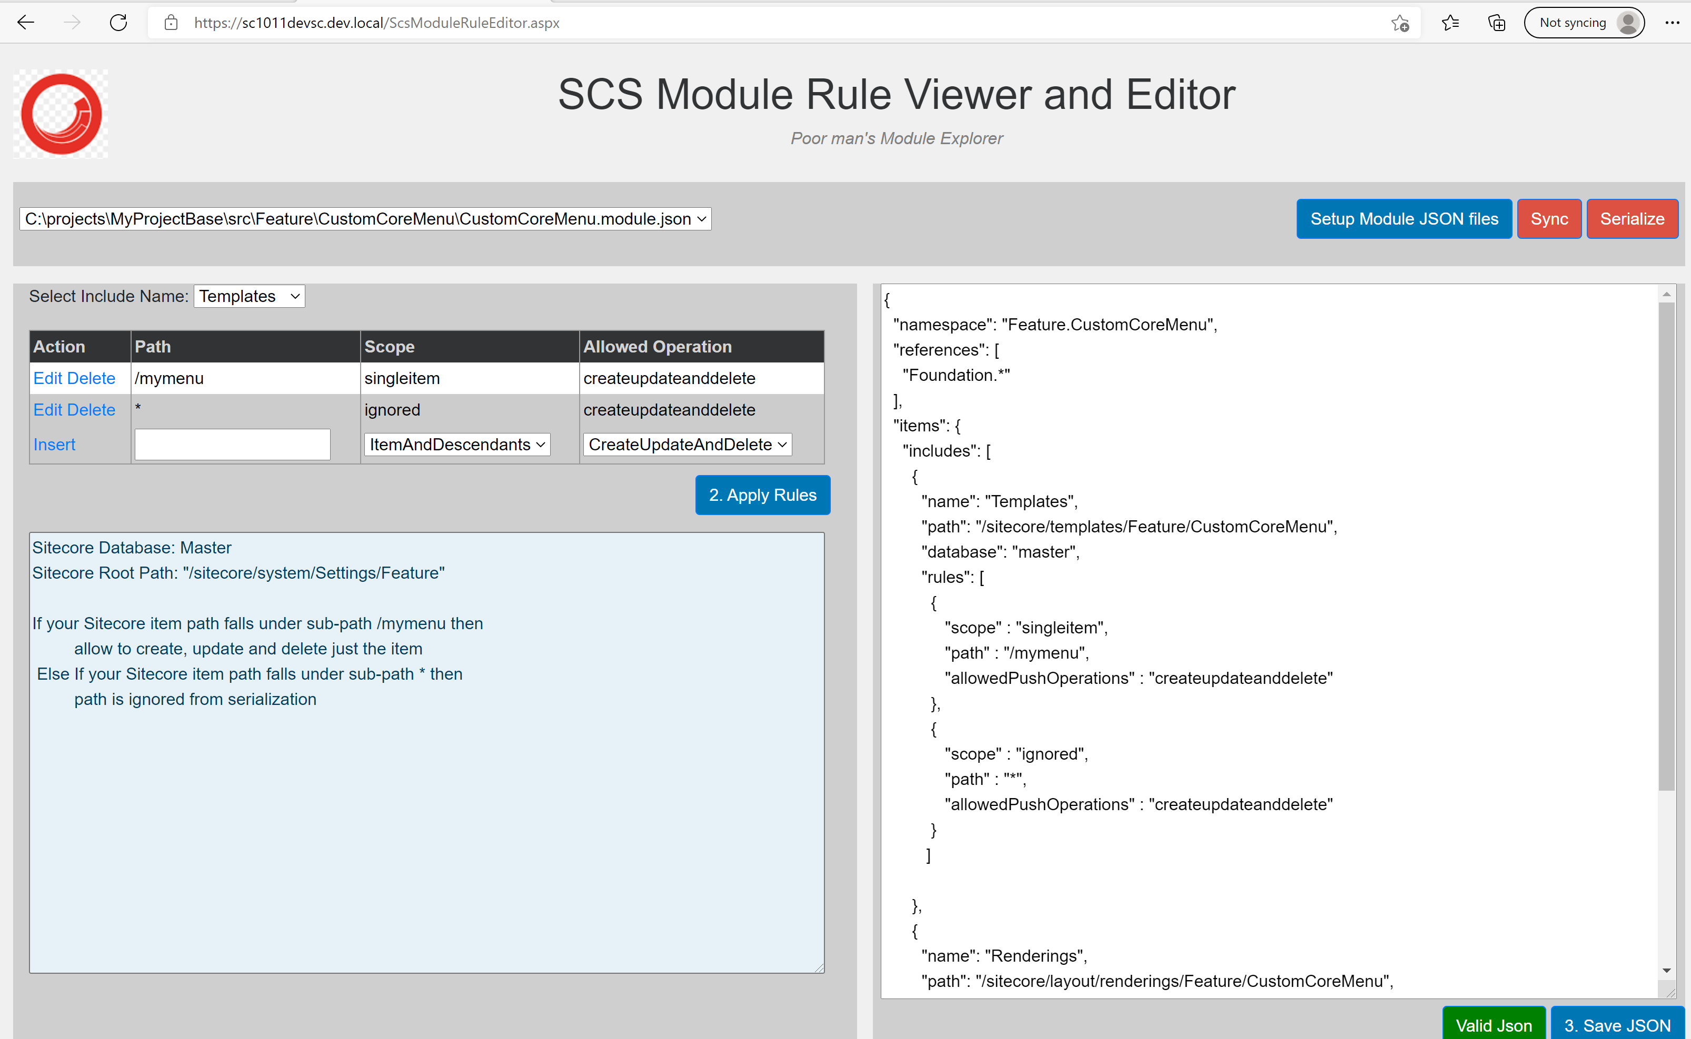
Poor Man’s Module Explorer

Slide 44
References
How to setup DevEx Serialization:
https://navansitecorenotes.blogspot.com/2021/03/sitecore-management-services-300-module.html
https://navansitecorenotes.blogspot.com/2021/03/create-item-package-using-sitecore-cli.html
How to setup HelixBase Project:
https://navansitecorenotes.blogspot.com/2021/07/using-helixbase-to-create-sitecore-1011.html
Errors:
https://navansitecorenotes.blogspot.com/2021/07/dotnet-sitecore-ser-push-or-dotnet.html
https://navansitecorenotes.blogspot.com/2021/07/dotnet-sitecore-login-command-error.html

Slide 45

Questions & Answers

Slide 46




What’s next?
Next Webinar: We are planning few webinars for next month. Stay tuned!
Call of Papers is Open for 2021. Please reach out to us at support@sugpune.in
Events Link: https://sugpune.in/events/
Job listings Link: https://sugpune.in/jobs/
Follow us on Twitter! Look for @sugpune
Join the group on LinkedIn too! Look for “Sitecore User Group Pune”
Also follow our page on Facebook! Look for “sugpune”

